Slide 1
PREDICTION OF LIVER DISEASE

Slide 2
PROBLEM STATEMENT
Given a dataset containing 584 patient details, our aim is to identity the features and target values to visualize the data ,draw an inference and predict whether the patient can be identified to be having (suffering from) liver disease or not.

Slide 3



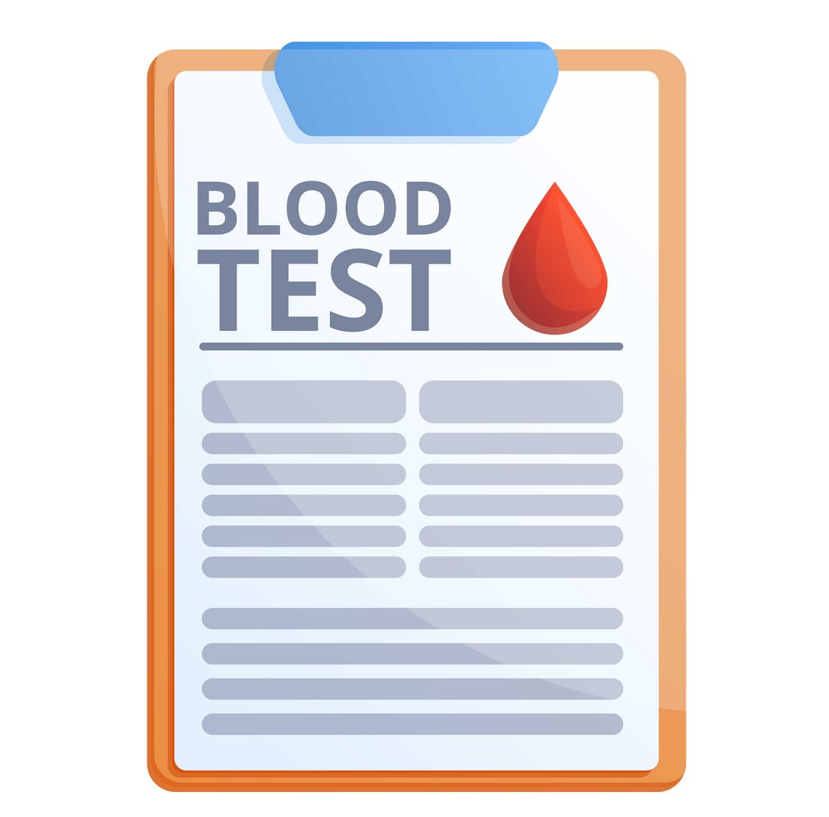
1) Patient goes to doctor 2) Doctor tells to perform certain tests
with certain symptoms such as blood test etc. based on
symptoms
4)Finally the doctors will analyse your 3)Patient takes the blood test and
report and then disease is identified submits the report to doctor

Slide 4

The aim of this mini project is to somewhat reduce the time delay caused due to the unnecessary back and forth shuttling between the hospital and the pathology lab .A machine learning algorithm will be trained to predict whether a person is suffering from liver disease or not.

Slide 5
A supervised machine learning approach
Under supervised machine learning approach it comes under classification model
Dataset is taken from UCI MACHINE LEARNING REPOSITERY.
Perform Data Analysis
Perform Data Visualization
Find out the features say (x)
Target Value say(y)
Perform prediction and draw conclusion whether patient can be identified to have liver disease or not
The data (features) can be obtained from patients blood test.

Slide 6
Features
Age
Gender
Total Bilirubin
Direct Bilirubin
Alkaline Phosphotase
Alamine Aminotransferase
Aspartate Aminotransferase
Total Proteins
Albumin
Albumin and Globulin Ratio
TARGET VARIABLE
Dataset
1 :- indicates the person is suffering from liver disease.
2 :- indicates the person is not suffering from liver disease

Slide 7
THANK YOU

